Slide 1
Monthly Balancing

Slide 2
Agenda
Monthly Checklist- Cognito
SAF Fundraiser Inventory/Profit and Loss-
How to Run the 19 Budget Report
How to Run the Cash Receipts Report
How to Run Open PO Reports
How to complete the Cognito form
2

Slide 3
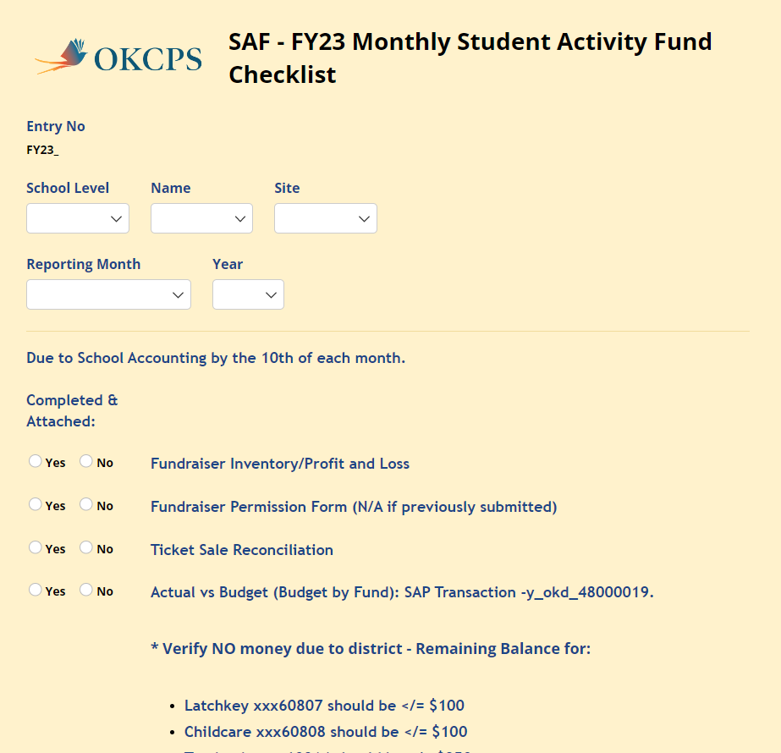
Monthly Check list- Cognito
Due by the 10th business day of each month Before noon
SAF - FY23 Monthly Student Activity Fund Checklist (cognitoforms.com)

Slide 4
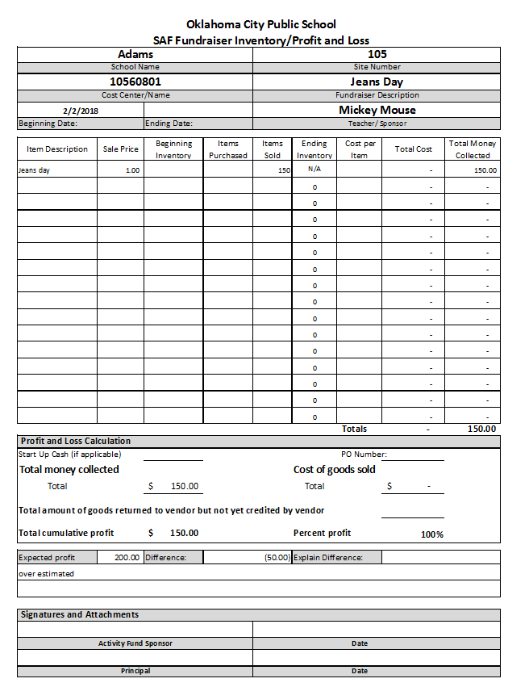
SAF Fundraiser inventory/Profit and Loss
Get the blank template off Accounting webpage.
Training is separate for this form.
This will change to Cognito soon
4

Slide 5
How to run 19 budget report
T Code: Y_OKD_48000019
Fund Is Always 60801 to 60999
Funds center is your 3 digit site number
Variant always EXP
Fiscal Year 2022-This will change each year.
Always use From period 1 to period 12
Clock to run report- This will take a few minutes to run.

Slide 6
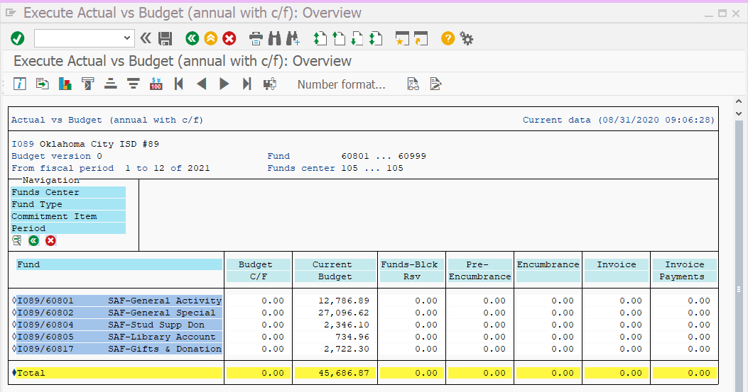
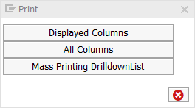
19 budget report (Cont’d)
Below is the 19 Report
Print
Choose all Columns
6

Slide 7
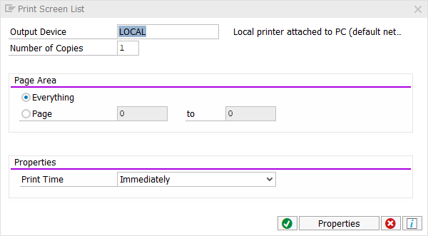
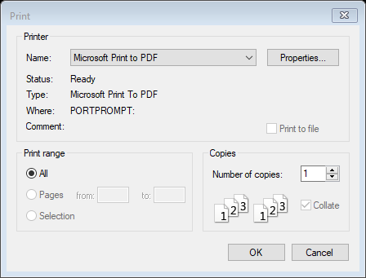
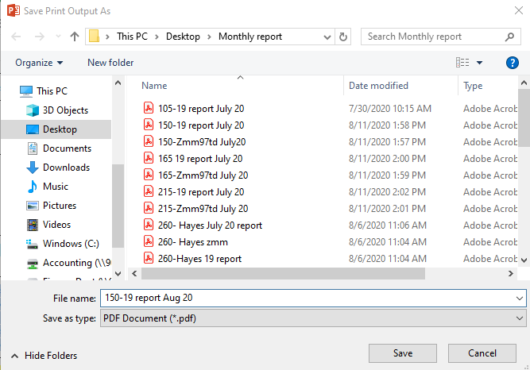
Print Screen List green check mark
Print- change from your printer to Microsoft Print to PDF
Save print Out put as: Put in you monthly report folder on your desk top
Save as 19 report the month and the year
7

Slide 8
T Code: Y_OKD_48000056
Document Type-CJ
Fiscal period-Put in the number to the month you want or leave blank for the whole year
1-July
2-August
3-September
4-October
5-November
6-December
7-January
8-February
9-March
10-April
11-May
12-June
Business area-60
Funds center-Site number
Remove your Name from SAP user ID
Uncheck include parked documents
Click the clock to run the report
To run report
8

Slide 9
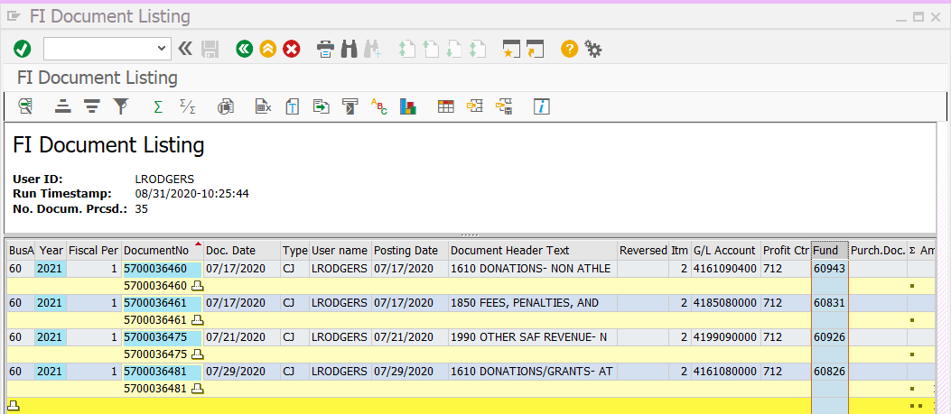
56 report (cont’d)
This is what the report looks like
Highlight the Fund column
Click the E/E icon
It will put the numbers in cost center order and total them by cost center

Slide 10
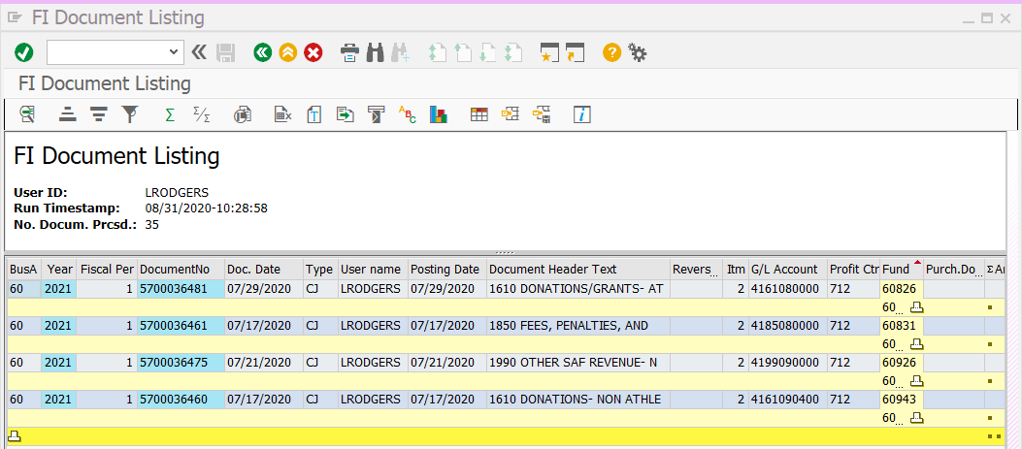
56 report (cont’d)
Now you can see what was receipted to your different cost centers for your profit/loss and Monthly balancing
Print the same way you did the 19 report.

Slide 11
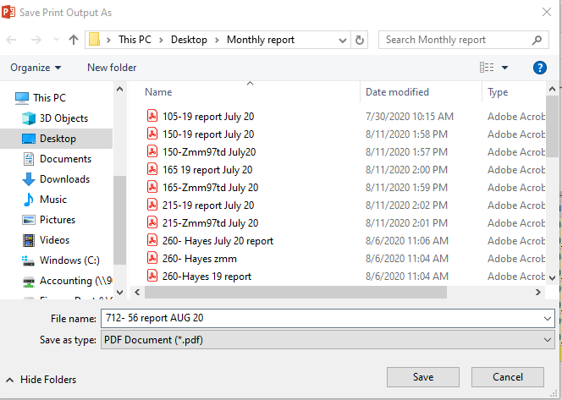
Print 56 report
Print ALV List green check mark
Print- change from your printer to Microsoft Print to PDF
Save print Out put as: Put in you monthly report folder on your desk top
Save as 56 report the month and the year

Slide 12
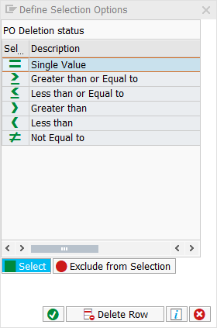
How to run an open PO report
T Code:ZMM97TD
PO Deletion Status- Double Click choose = Single value, Click green check mark
Fund Center is your Site Number
PO Number
SAF- 4923000000 to 4923999999
Red numbers indicate FY this will change each year
Click the clock
12

Slide 13
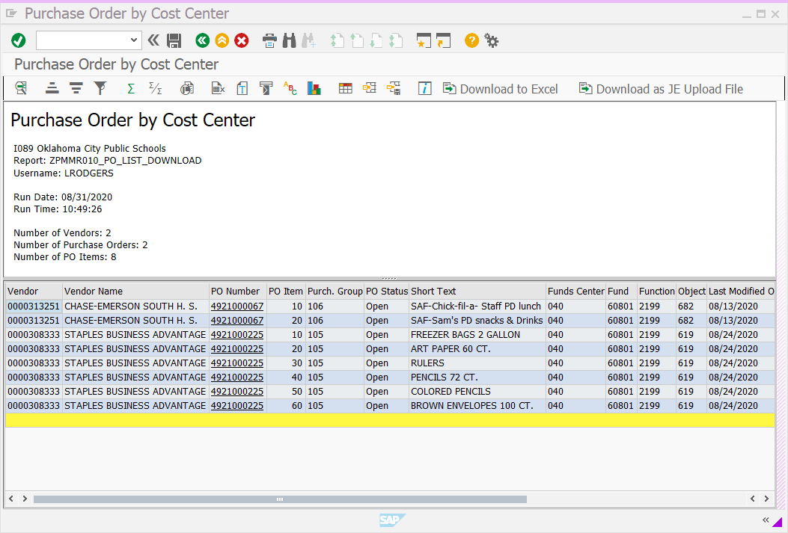
Zmm97TD
This is what it will look like

Slide 14
Print Zmm97td
Print ALV List green check mark
Print- change from your printer to Microsoft Print to PDF
Save print Out put as: Put in you monthly report folder on your desk top
Save as 56 report the month and the year

Slide 15
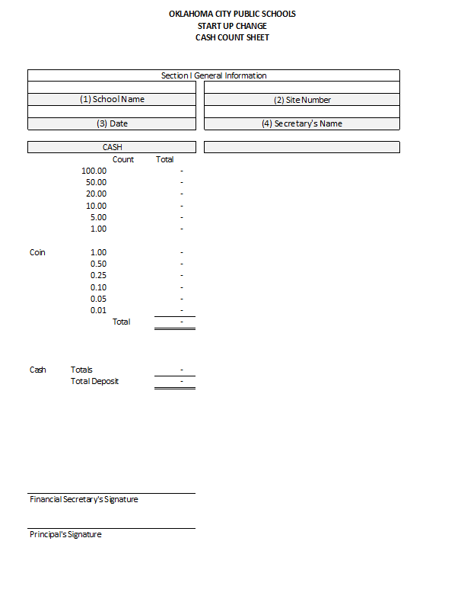
Cash Count for Athletic Change fund
If your school has the change fund for athletics a cash count sheet dated the last day of the month must be attached to your monthly balancing.

Slide 16
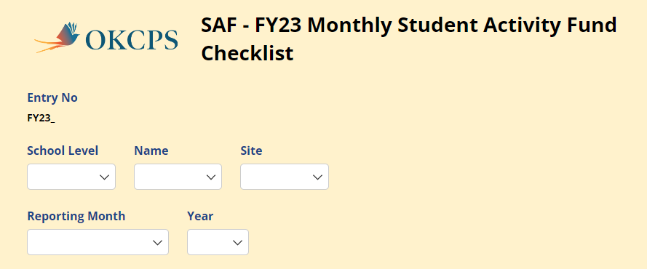
Cognito Form
This comes in 5 Parts
Part 1 School information fill out completely

Slide 17
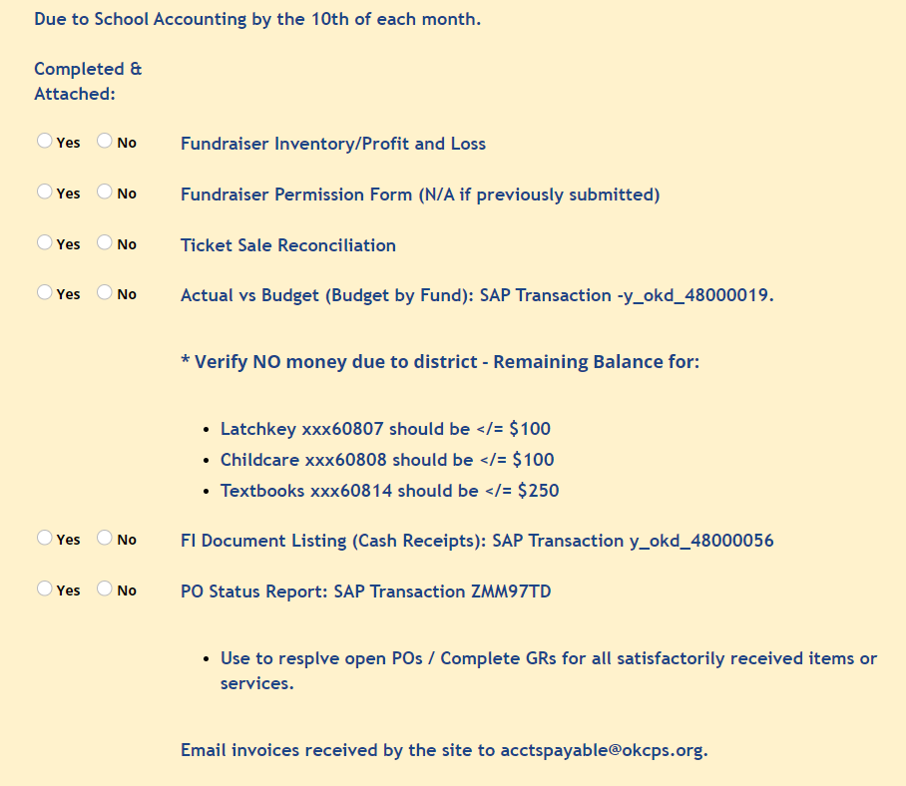
Part 2: Report information Click all that apply

Slide 18
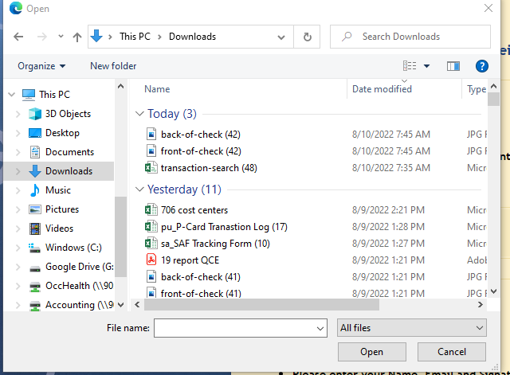
Part 3- Backup documents

Slide 19
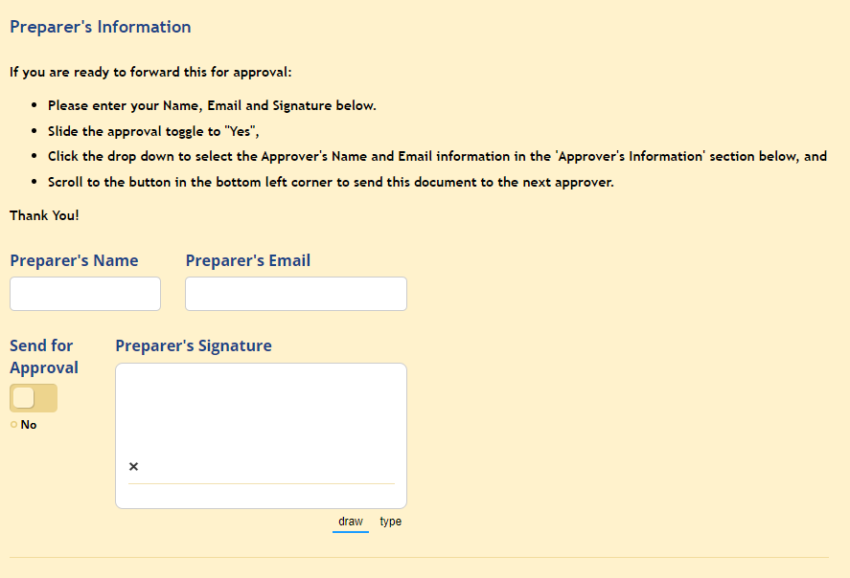
Part 4- Signatures- Preparer’s Info

Slide 20
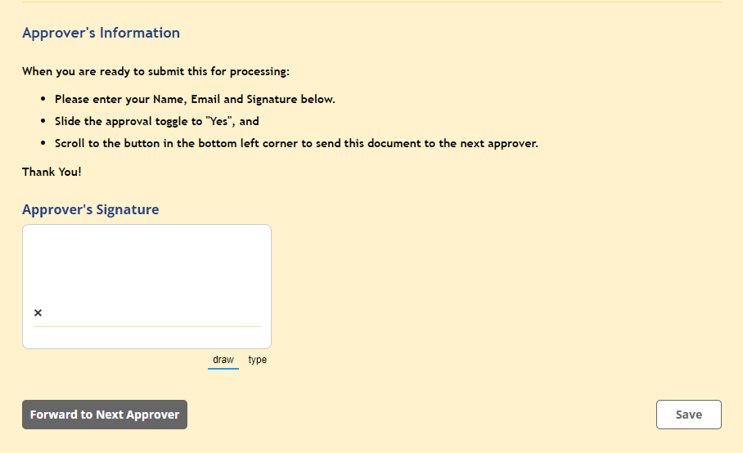
Part 5- Signatures- Approver’s Info

Slide 21
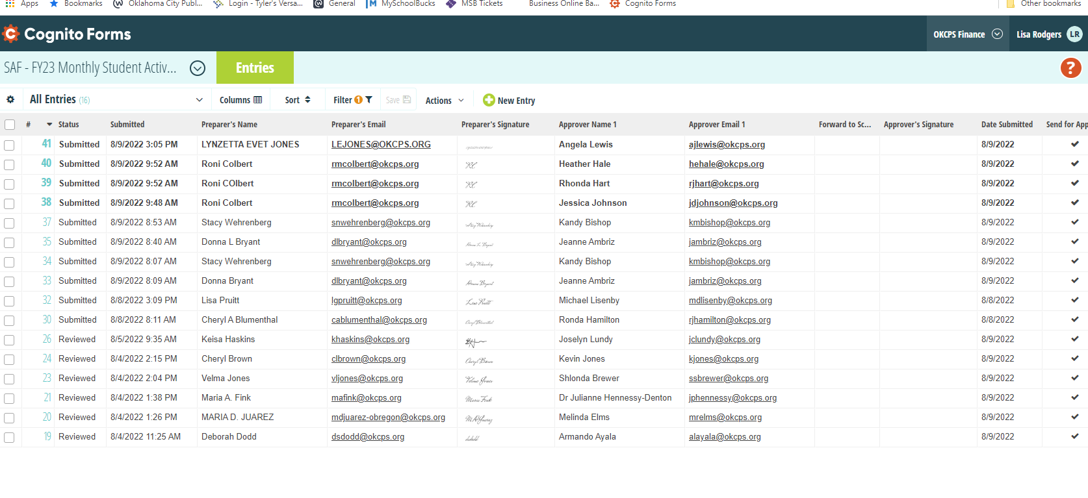
Once you start your monthly report Accounting will see your progress.
21

Slide 22
Questions?

